Slide 1

Introduction to Programming Languages

Slide 2

Course Overview
The Language of Programming Languages
Programming Language Design
Course Overview

Slide 3

Course Overview
Let’s look at canvas!
Course Overview

Slide 4
A Question
Have you ever programmed a computer?
Course Overview

Slide 5
Why study programming languages?
To better understand:
How computers work.
How to select a proper language.
How to learn new languages.
Don't specialize in one language!
Course Overview

Slide 6
Languages I have Used in Industry
C
PHP
Python
ASP.Net with C#
C++
JavaScript
C#
Java
ASP.Net with VB
PERL
VB.Net
Shell Script
Traditional visual basic
Assembly (Various Processors)
FORTRAN
BASIC
Lua
FORTH
COBOL
RPG IV
Ada
MUMPS
FoxPro
RPG III
Pascal
Erlang
Scheme
Delphi
Cold Fusion
Objective C
Course Overview

Slide 7
Course Overview
The Language of Programming Languages
Programming Language Design
The Language of Programming Languages

Slide 8
Language Categories
Most Languages are Multi-Paradigm
Many Classifications
Common Set:
Imperative
Functional
Logic
Object Oriented
Language

Slide 9
Imperative Languages
for(int x=0; x<=10; x=x+1) { System.out.printf("%d\n", x); }
It's all about State
Checking State
Modifying State
Maintaining State
Probably how you think about coding!
Language

Slide 10
Functional Languages
(let loop ((n 1))
(if (> n 10)
'()
(cons n (loop (+ n 1)))
)
)
There is no state.
It's all about recursive structure!
A more elegant weapon for a more civilized era.
Preferred by Wizards
Language

Slide 11
Logic Languages
count_ten(10) :- write(10), !. count_ten(X) :- write(X), nl, Next is X + 1, count_ten(Next). count_ten(1).
Works by logical assertion.
Once defined, a thing is what it is (A=A).
Preferred by Philosophers
Language

Slide 12
Object Oriented Languages
Counter c = new Counter(); c.setLimit(10); c.setValue(1); while(! c.done() ) { System.out.println(c.getNext()); }
A refinement of imperative programming.
All about abstraction!
Preferred by project managers and programmers with deadlines.
Language

Slide 13
Language Domains
Some Languages are Domain / Task Specific
COBOL – Common Business Oriented Language
RPG – Report Program Generator
MUMPS – Massachusetts General Hospital Utility Multi-Programming System
Most languages are General Purpose
JAVA
C/C++
Etc.
Language

Slide 14
Evaluating Programming Languages
 | CRITERIA
Characteristic | Readability | Writability | Reliability
Simplicity | • | • | •
Orthogonality | • | • | •
Data Types | • | • | •
Syntax Design | • | • | •
Support for Abstraction |  | • | •
Expressivity |  | • | •
Type Checking |  |  | •
Exception Handling |  |  | •
Restricted Aliasing |  |  | •
Language

Slide 15
Simplicity
Goes To: Readability, Writability, and Reliability
Small Number of Constructs
Common Problems:
Feature multiplicity
x=x+1;
x++;
++x;
x+=1;
Operator Overloading
Language

Slide 16
Orthogonality
Goes To: Readability, Writability, and Reliability
Do all features exist for all constructs?
Something like this: msg= "Total: " + x + y
Versus something like this: msg="Total: " . str(x+y)
Language

Slide 17
Data Types
Goes To: Readability, Writability, and Reliability
What types are defined?
Is the language strongly typed?
What data structures facilities are present?
Language

Slide 18
Syntax Design
Goes To: Readability, Writability, and Reliability
Does the syntax use a lot of esoteric symbols?
Are there a lot of keywords?
Does appearance match function?
Language

Slide 19
Support for Abstraction
Goes To: Writability, and Reliability
Can we make abstract types?
Can we establish common interfaces?
Can we express the fact that all squirrels are mammals, all mammals give milk, therefore all squirrels are milkable?
Language

Slide 20
Expressivity
Goes To: Writability, and Reliability
Can you get a lot of work done with little code?
Consider this: x = x + y
Versus: MOV AX, (X) ADD AX, (Y) MOV (X), AX
Language

Slide 21
Type Checking
Goes To: Reliability
Does the language save you from strange and/or dangerous combinations?
double d=1.0;
int x=0; d=x; x=d;
Language

Slide 22
Exception Handling
Goes To: Reliability
Expect the unexpected!
How do you cope?
Does the langage provide alternate return paths?
Language

Slide 23
Restricted Aliasing
Goes To: Reliability
The ability to reference everything is dangerous!
One name, one variable, is often best.
Language

Slide 24
Course Overview
The Language of Programming Languages
Programming Language Design
Programming Language Design

Slide 25
Programming Language Design
Why do people design new programming languages?
What factors influence how they design languages?
Does the world need more programming languages?
Design

Slide 26
Influence
Machine Architecture
Programming Methodologies
Technology and Needs of the Day
Design

Slide 27
Architecture
Memory
I/O
CPU
Design

Slide 28
Programming Methodologies
Evolution of Methodoligies
We think in assembly language.
Structured Programming
Stepwise Refinement (Top-Down Design)
Multiple Coding Teams
Software Engineers
Design

Slide 29
Technology & Needs of the Day
Are you coding on punched cards?
Are you working with graphics?
What I/O devices do your users have?
How does this affect your programming needs?
Design

Slide 30
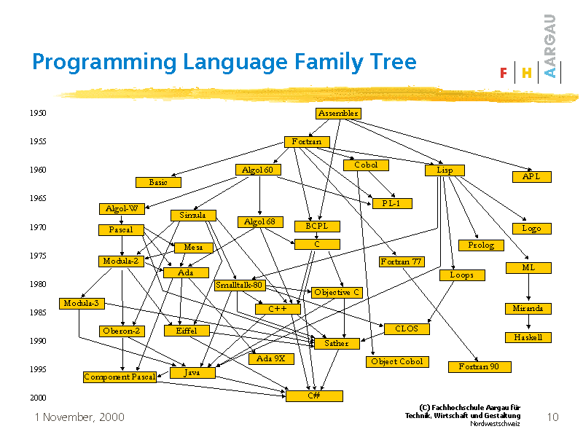
Evolution of Modern Programming Languages
Design

Slide 31
Assignment
Reading
Read Chapter 1
Skim Chapter 2
Group Work
Introduce yourself in Teams
Begin work on the first programming assignment
Reading

